Slide 1

Improving your hotel search experience
Group 7

Slide 2
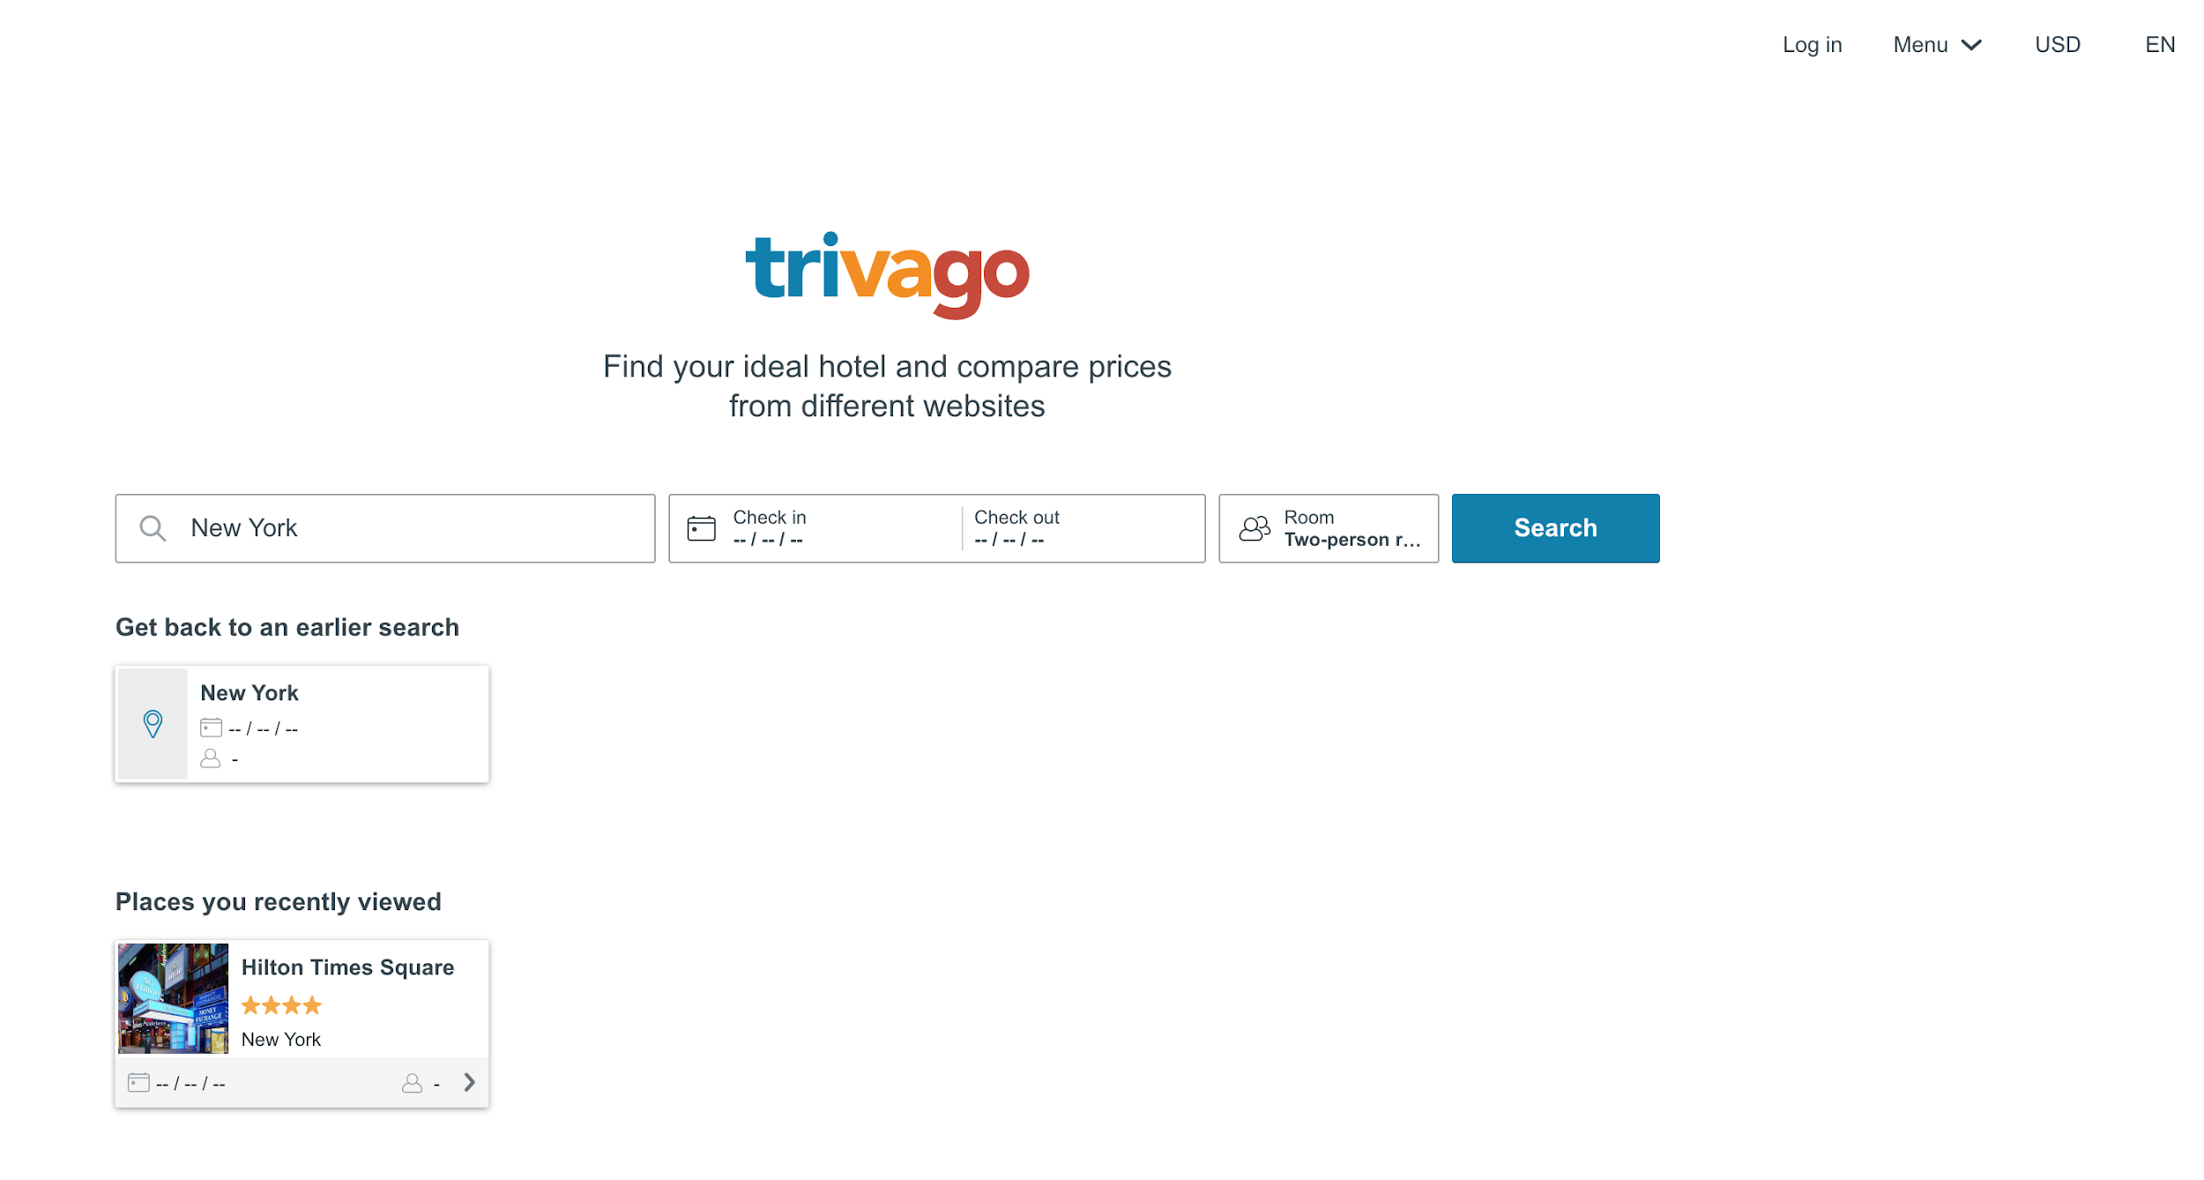
What is trivago?
trivago is a German company specializing in services related to hotel, lodging, and meta search fields.
Users can search based on the best deals, location, rating, free breakfast, and other fields.

Slide 3
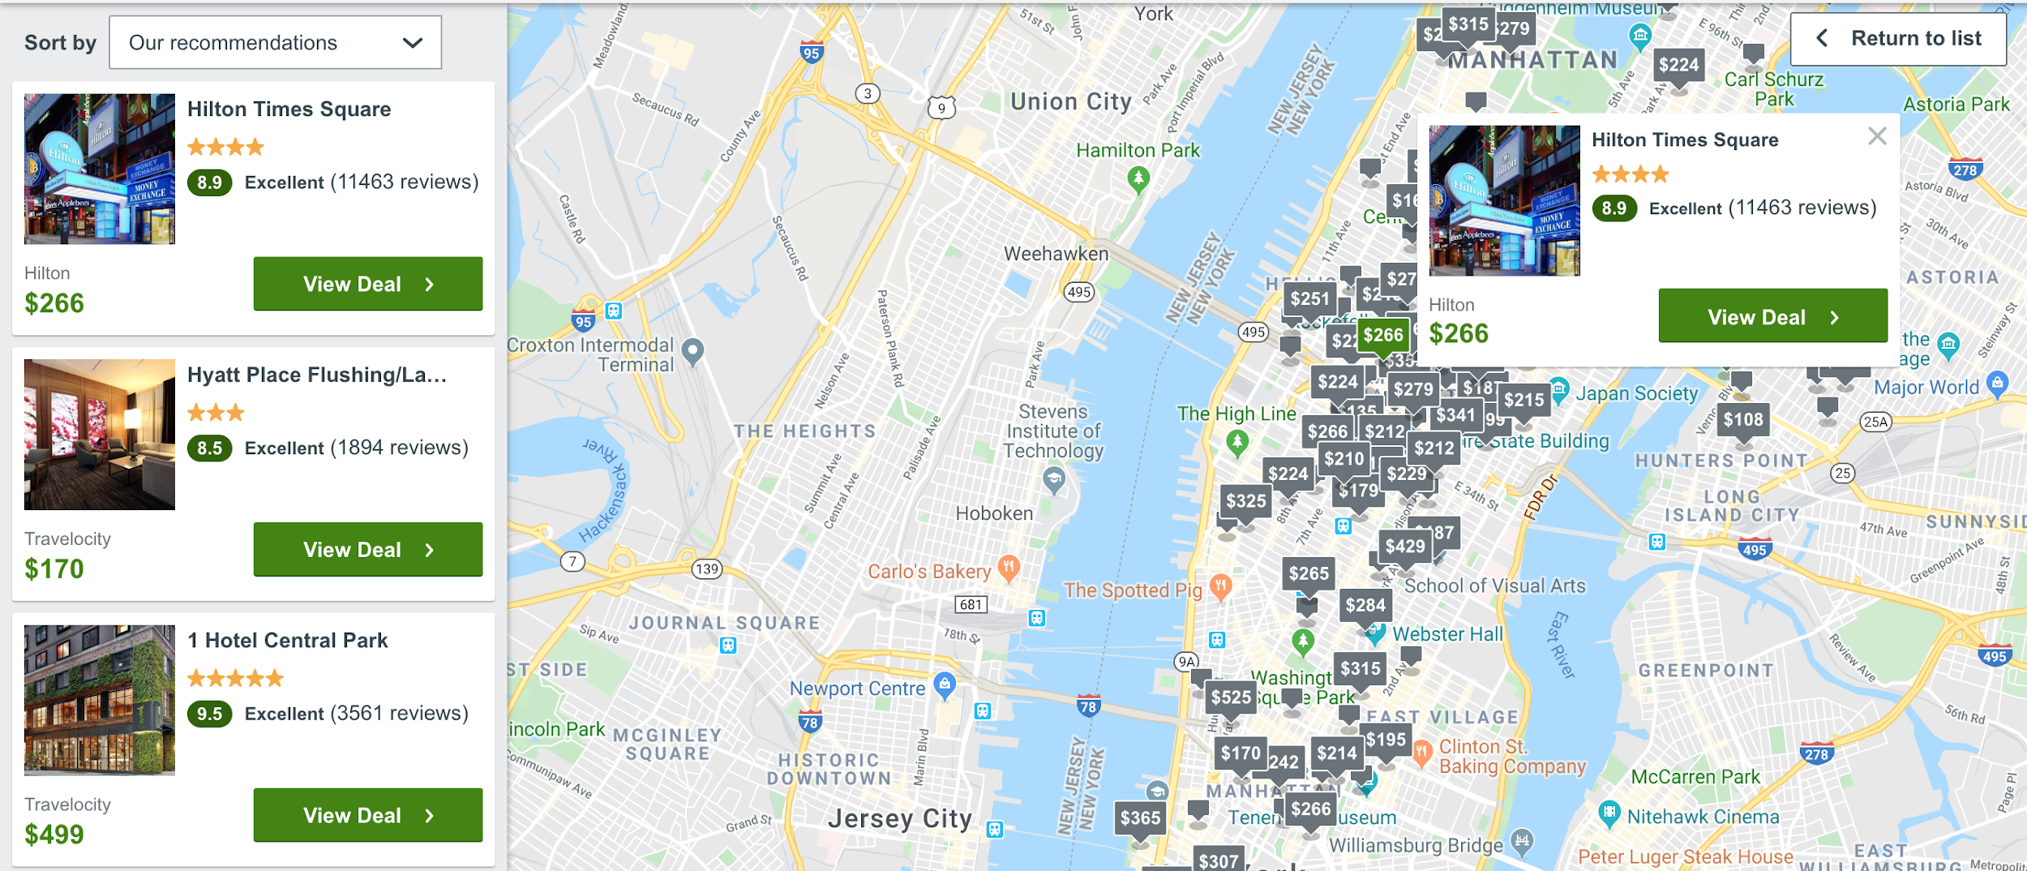
What’s the problem?
The current trivago design is confusing and cluttered with a lot of functionality hidden to the user.
We want to improve the website to help the user have a simple, straightforward experience when finding hotels for their vacations.

Slide 4
Goals
An improved visual interface for the user
Reducing white space
Improving contrast
Rearrange top right menu links
Reduce clutter on hotel cards
Make price filter clear
Improve dropdown menu
Improve font readability
Make trivago more intuitive for the user
Improve functionality
Improve filters for searching
Current website can be difficult to wade through to find the hotel you need

Slide 5
User Requirements
User interface should reduce unused white space without adding unnecessary clutter.
Filter fields utilizing numerical values should have input boxes to improve user ability.
Menus should be easily readable and traversable.

Slide 6
Major Functions
Searches for hotel deals based on dates, locations, size and style
Filters results based on the number of stars, user reviews, vacation rentals
Displays a general map of the area where the hotels are
Jumps to the hotel’s website for booking once selected

Slide 7
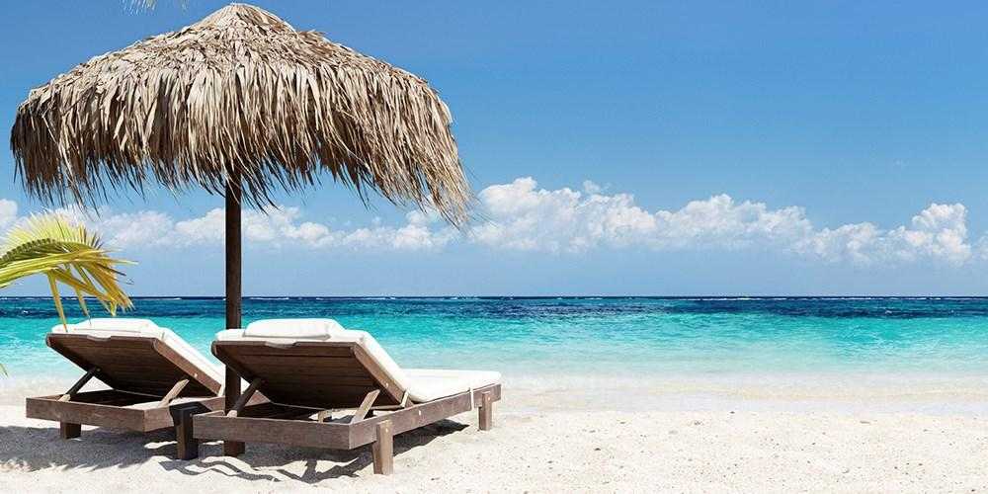
Environment
The website is accessible via the internet through computer or smartphone with sufficient memory available
User should have enough time to decide on important filters and specifications for their hotel needs
User should have a destination in mind

Slide 8
Team members’ roles
Gannt Chart Creation/updating: Jack Primiani
UI/UX Team: Brendan Gigliotti & Nick Tindall
Developers: Lauren Nix, Hendrick McCullar, & Adam Power

Slide 9
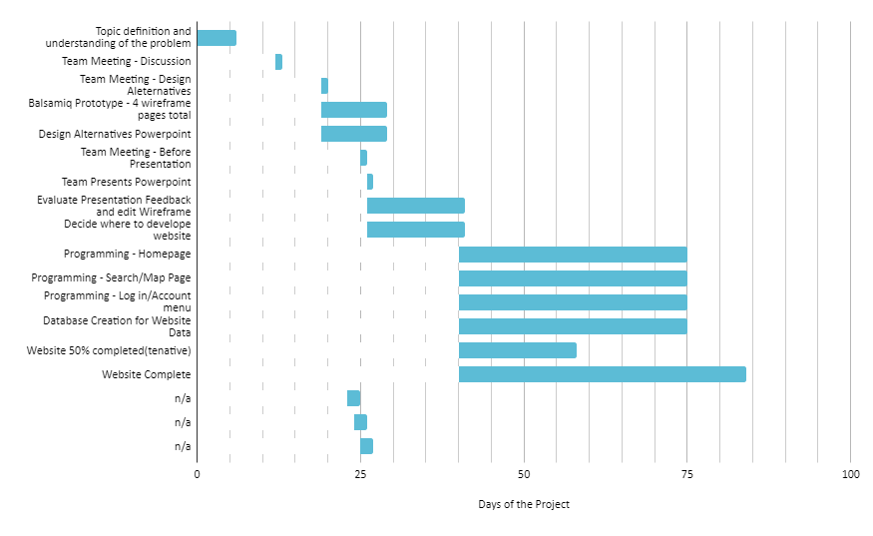

Slide 10
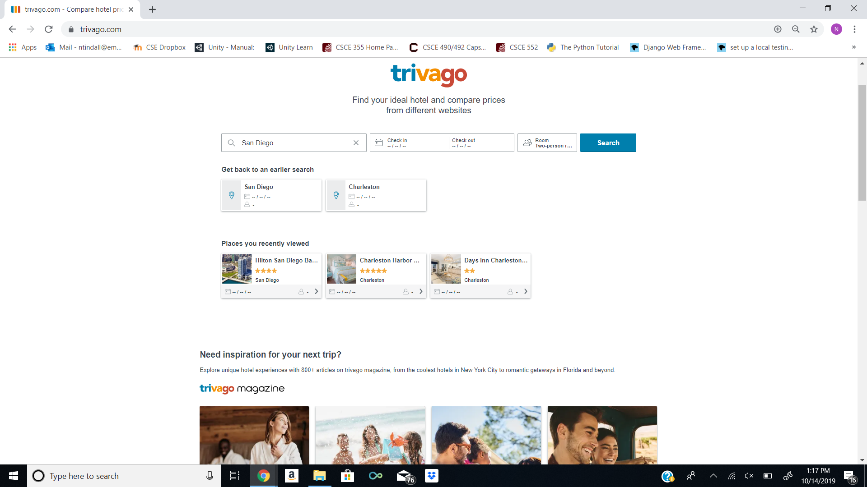
Trivago’s Homepage

Slide 11
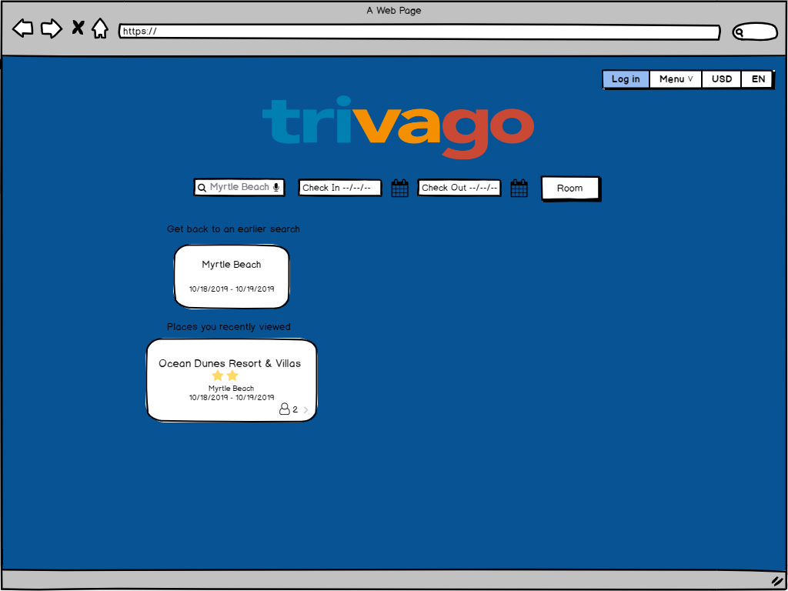
Our Homepage:
Took out magazine ads
Changed the background color.

Slide 12
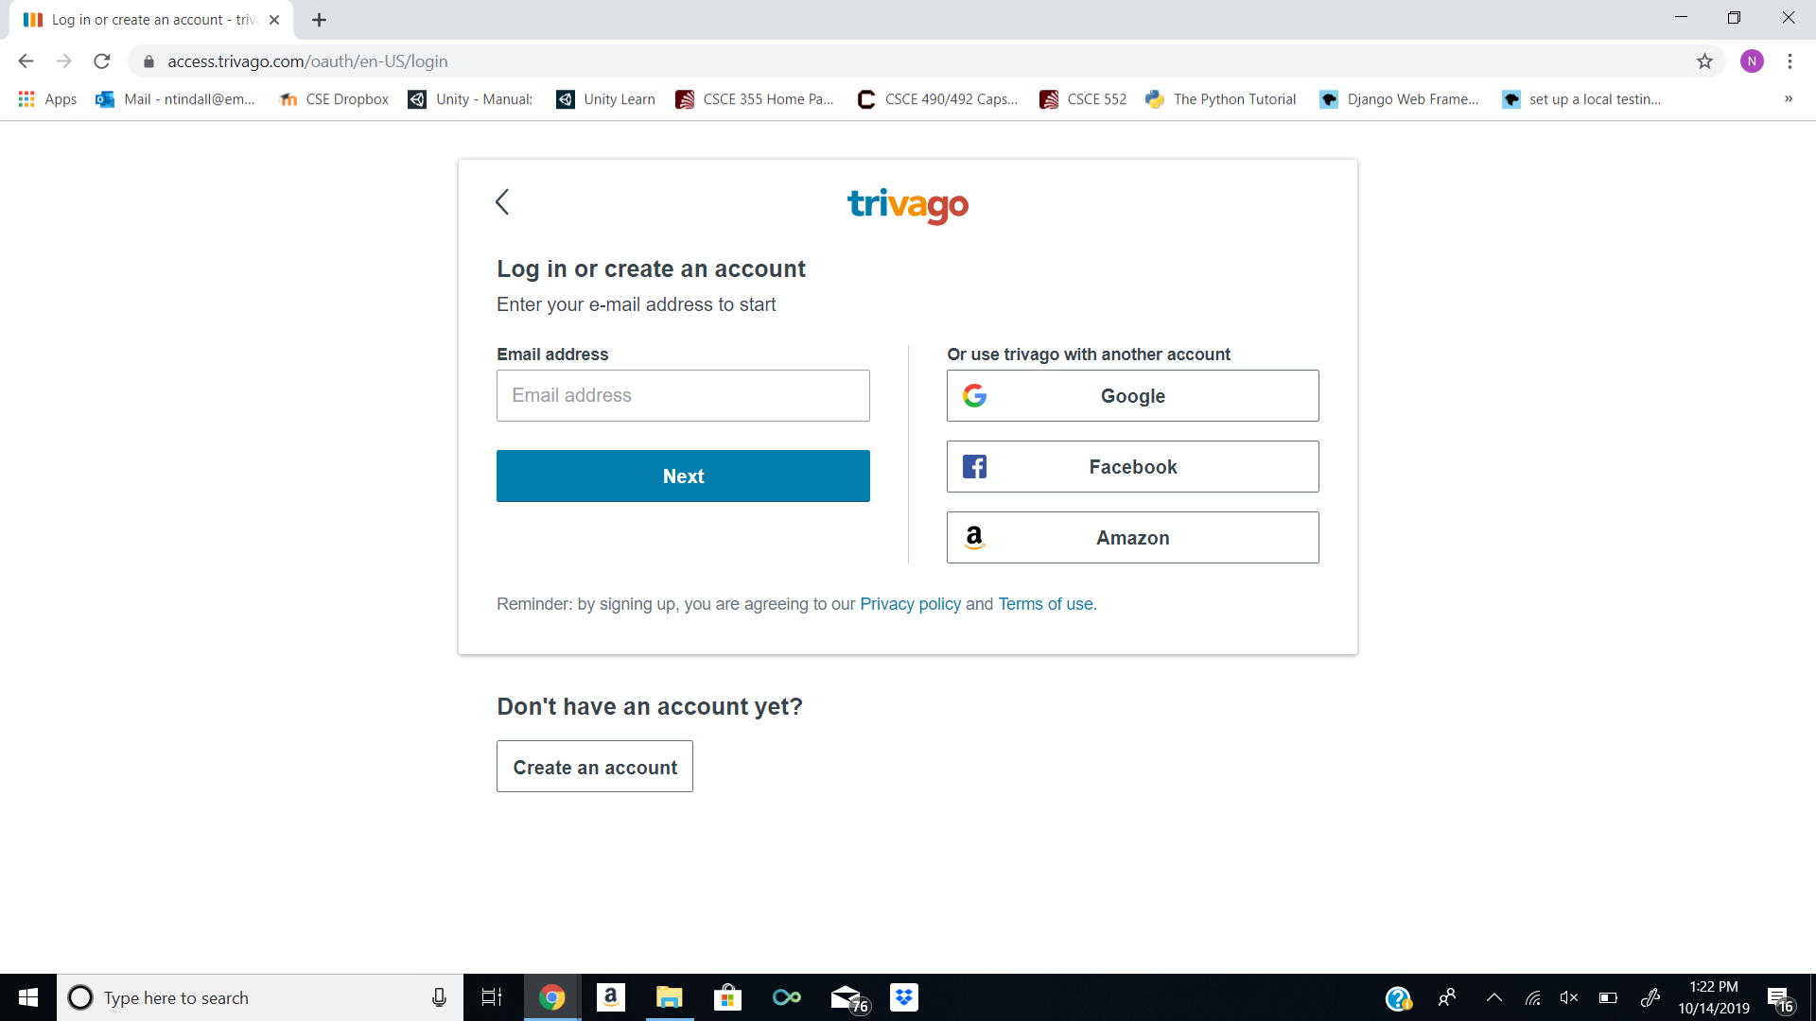
Trivago’s Log In

Slide 13
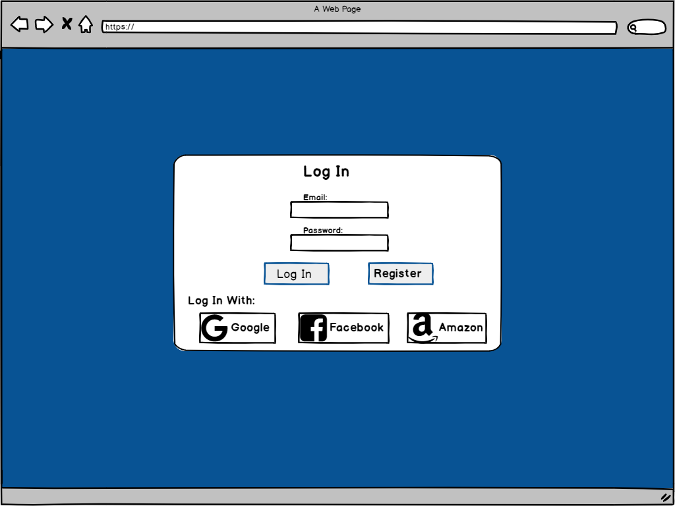
Our Log In
Changed the layout of the buttons.
Once again the background color is changed.

Slide 14
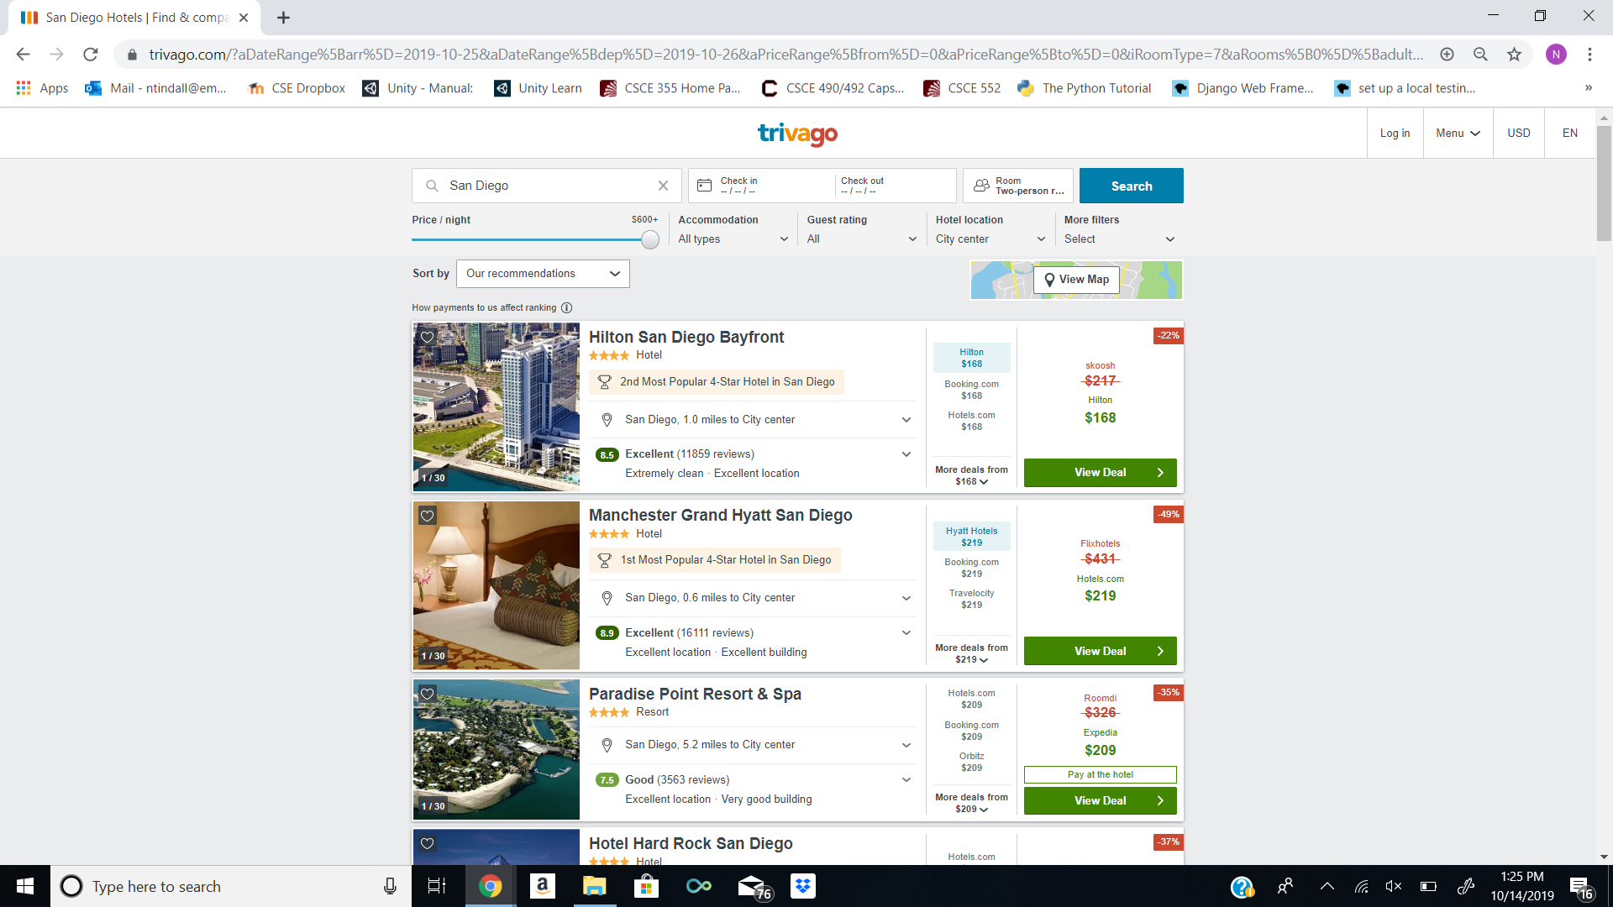
Trivago’s Search Page

Slide 15
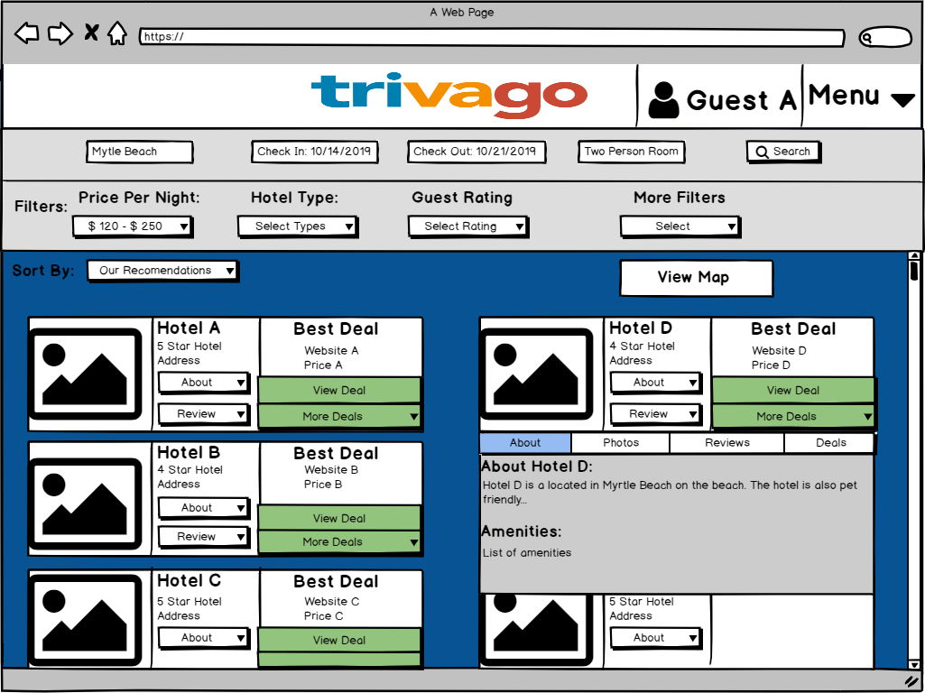
Our Search Page
2 rows of card, to better utilize empty space.
Once again the background color is changed.

Slide 16
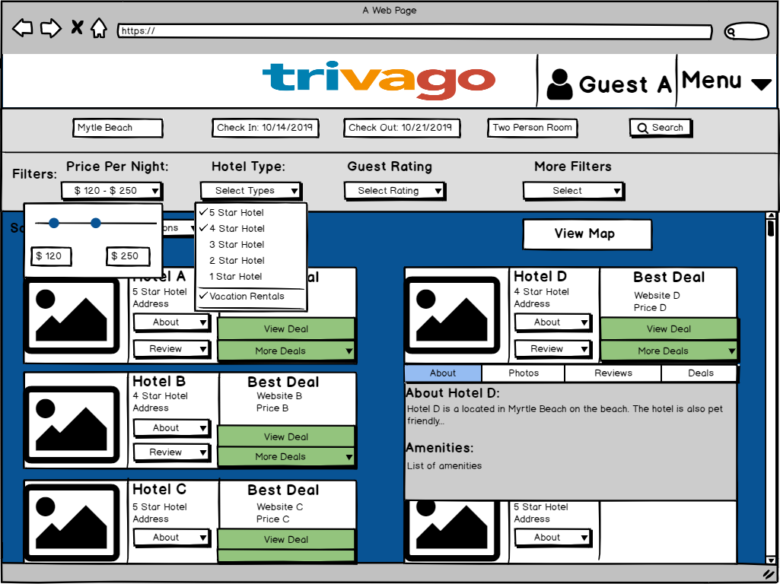
Menus
Changed a few of the filters.
Implemented a price range.

Slide 17
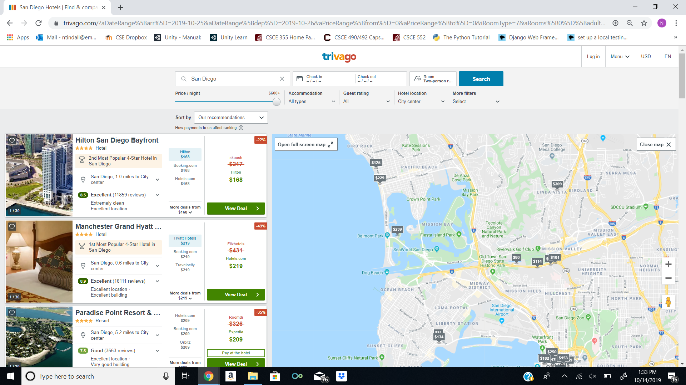
Search Page With Map

Slide 18
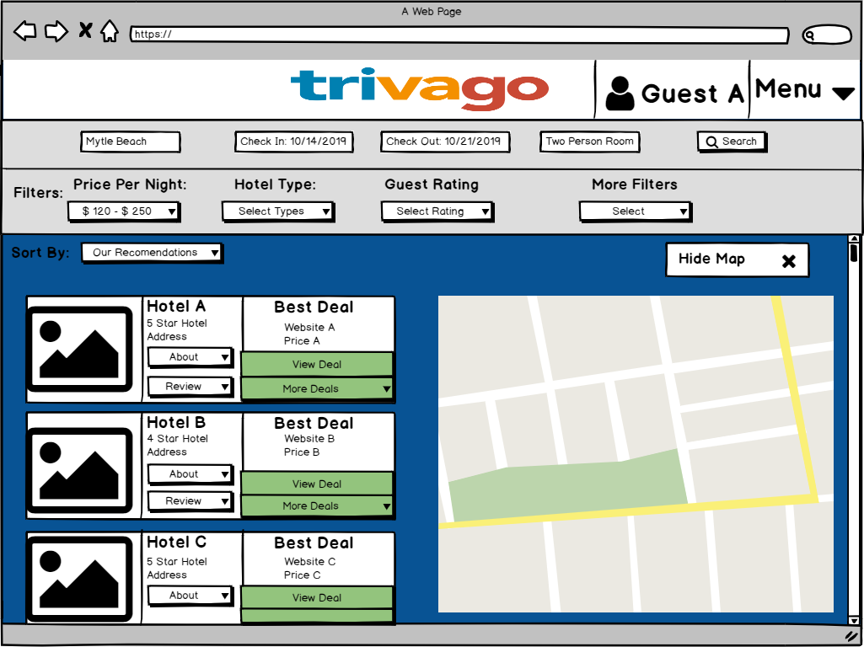
Our Search Page
Slightly smaller map.

Slide 19
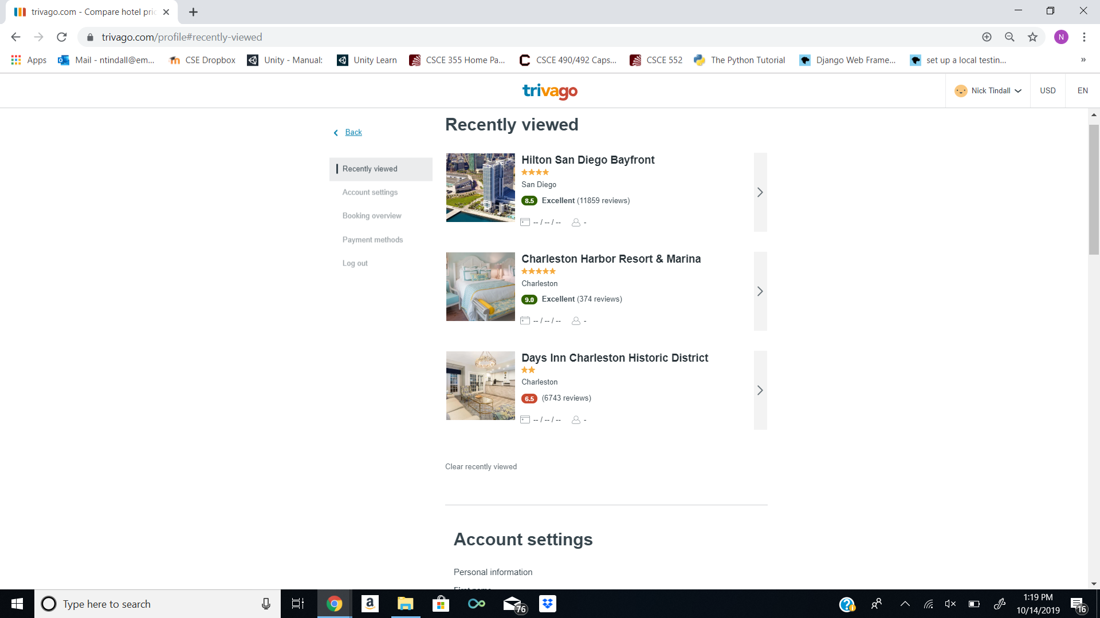
Trivago’s Menu Page

Slide 20
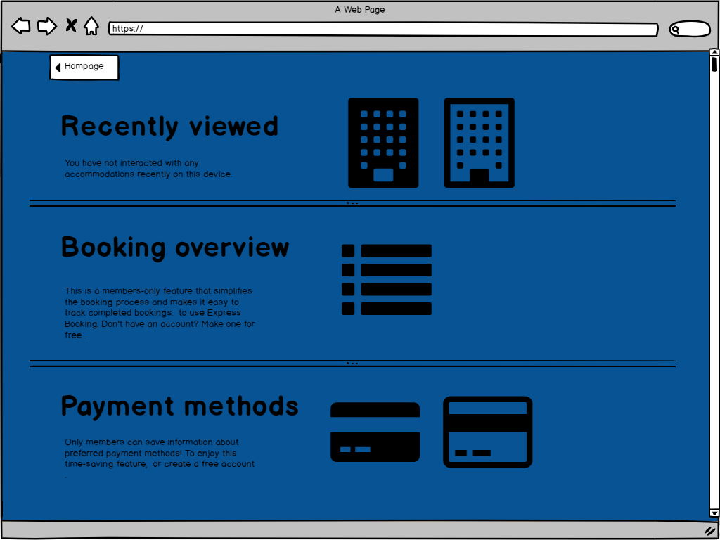
Our Menu Page
Changed the background color

Slide 21
Q & A
What do you think of the overall design?
Color scheme? Contrast?
Search page: is it too cluttered with information?
Is there any functionality that could be added to the search page?
When you’re planning a trip, what’s the most important aspect of a hotel to you?
What is your preferred hotel or vacation search engine? (Travelocity, Expedia, Airbnb, etc)

